Slide 1
Bus. Communication Class 2 Dr. Clara Ma Have you ever listened to a presenter who sounded super smart – without having any ideas what she really said?

Slide 2
1. Warmup: Kahoot 2. Review SUCCESSs 3. Group Presentation Debrief 4. Sharing feedback 5. Culture in Communication 6. Public Communication 7. Feedback

Slide 3
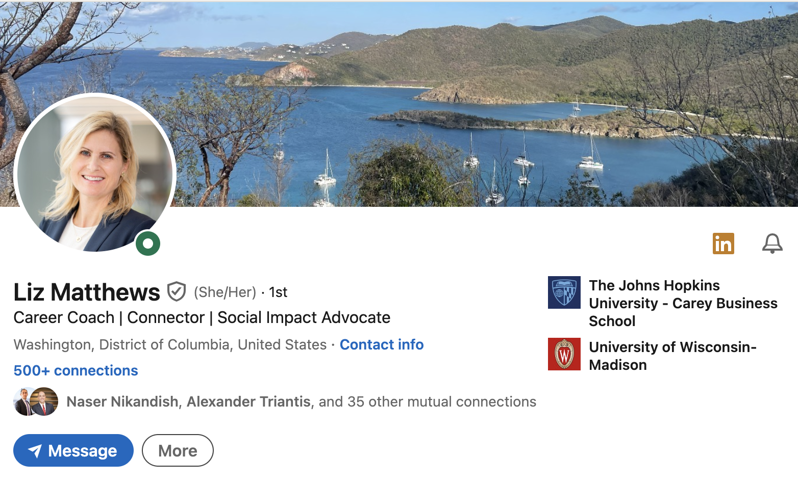

Slide 4

Your reader or audience always wonders…
What’s In It For Them?
(WIIIFT)

Slide 5
And don’t forget the all-important factor: High Skim Value
So how do you get high skim value?

